Slide 1
CS 0007: Introduction to Java
Lecture 8
Nathan Ong
University of Pittsburgh
September 27, 2016

Slide 2
Announcement
Your midterm exam is scheduled for Tuesday, October 11, during the normal class period.
Anything from the lecture, homework, quiz, labs, is fair game.
You should also be comfortable with analyzing previously unseen code in conjunction with using the API (as seen in several homeworks).

Slide 3
Function Components
Visibility type (public/protected/private)
static (For now, required)
Return Type
functionName
Parentheses “()”
  Parameters
  Type1 parameterName1
  Type2 parameterName2
  …
Curly Brackets/Braces “{}”
  return a value
Function
Header
Function
Body

Slide 4
Function Overloading
Sometimes, the function name that was already used fits perfectly with a function you need to create
They have similar functions, but operate on different parameters
Turns out, you can use the same name, in what is called function overloading

Slide 5
Function Overloading Rules
Functions with the same name MUST have different typed parameters, or a different number of parameters.
We have seen this before!!! (System.out.println())

Slide 6
Examples
public static void britishGreeting
(String fullName)
public static void britishGreeting
(String yourName, String childName)
public static int britishGreeting
(int numOfPeople)
public static char britishGreeting
(String firstNameOnly)

Slide 7
Special Functions
Constructors: Functions that create new objects, preceded by the keyword new before calling it.
main: The first function that is always run by any Java program. It always has a String[] as the only parameter.
Functions common to all objects: we may return to this later.

Slide 8
If Statements
And More Booleans and Scope

Slide 9
If Statements
English usage?
“If it will rain today, then I will bring my umbrella.”
Rain today would indicate that I have brought my umbrella
Cause and effect relationship: when a condition is met, a behavior is elicited.

Slide 10
Skeleton Statement
if(<boolean condition>)
{
…
}
…

Slide 11
Boolean Condition
Must evaluate to true in order for the statements within the if-block to execute.
Evaluating to false will skip the block.

Slide 12
Java Example
/* checkWeather returns true if it
* will rain today.*/
boolean rainToday = checkWeather();
if(rainToday)
{
bringUmbrella();
}
goToSchool();

Slide 13
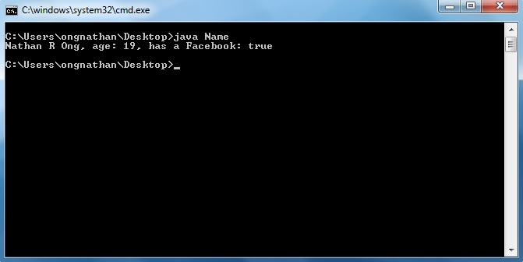
Remember this?
"has a Facebook: true“
How do we fix this?

Slide 14
Code Reminder
public class Name
{
public static void main(String[] args)
{
String firstName = "Nathan";
char midInitial = 'R';
String lastName = "Ong";
int age = 19;
boolean hasFacebook = true;
System.out.println(firstName + " " + midInitial + " " + lastName + ", age: " + age + ", has a Facebook: " + hasFacebook);
}//end method main
}//End class Name

Slide 15
A More Useful Output
if hasFacebook is true, then print what?
"has a Facebook"
Otherwise, if hasFacebook is false, then print what?
"does not have a Facebook"

Slide 16
if()
if hasFacebook is true, then print "has a Facebook"
if(hasFacebook is true)
{
System.out.println("has a Facebook");
}//end block if(hasFacebook is true)

Slide 17
hasFacebook is true
How do we model this?
hasFacebook = true; //?
But that let us do name-changing!
name = "Brandon Ong";

Slide 18
Making a new thing:
Type name = value;
Changing the old thing: name = newValue;
Notes:
Remember this (from slide 20)?

Slide 19
hasFacebook is true
How do we model this?
hasFacebook = true //?
But that let us do name-changing!
name = "Brandon Ong";
So no, we can't do this to check for equality
We instead use double equals (==)

Slide 20
== vs =
= is for assignment
  String name = "Nathan Ong";
  name has value?
  int age = 19;
  age has value?
== is for comparison (equal or not equal)
  age == 19;
  name == "Nathan Ong";
What values do we get for the last two statements?
What type are they?

Slide 21
WARNING
Be careful when comparing non-primitive values!!!
name == "Nathan Ong" could actually give us false!
Instead you will need to use equals()
name.equals("Nathan Ong");

Slide 22
if()
if hasFacebook is true, then print "has a Facebook"
if(hasFacebook == true)
{
System.out.println("has a Facebook");
}//end block if(hasFacebook == true)
But how do I represent when hasFacebook is false?

Slide 23
else if()
If an if condition fails (the boolean condition evaluates to false), it will check the condition for the subsequent else if.
Can also be placed directly after another else if block (i.e. you can have several).

Slide 24
else if()
Otherwise, if hasFacebook is false, then print "does not have a Facebook"
else if(hasFacebook == false)
{
System.out.println("does not have a Facebook");
}//end block else if(hasFacebook
// == false)

Slide 25
else if()
if(hasFacebook == true)
{
System.out.println("has a Facebook");
}//end block if(hasFacebook == true)
else if(hasFacebook == false)
{
System.out.println("does not have a Facebook");
}//end block else if(hasFacebook == false)
Seems kinda wordy…

Slide 26
hasFacebook == true
What does that give us?
What type?
hasFacebook == true when hasFacebook = true gives us?
hasFacebook == true when hasFacebook = false gives us?
hasFacebook == true → hasFacebook
*Gasp*

Slide 27
if()
if(hasFacebook)
{
System.out.println("has a Facebook");
}//end block if(hasFacebook)
else if(hasFacebook == false)
{
System.out.println("does not have a Facebook");
}//end block else if(hasFacebook == false)
Still kinda wordy…

Slide 28
hasFacebook == false
We want to use the same trick we did before, except this time with false instead of true.
Remember the boolean operators?

Slide 29
if()
if(hasFacebook)
{
System.out.println("has a Facebook");
}//end block if(hasFacebook)
else if(!hasFacebook)
{
System.out.println("does not have a Facebook");
}//end block else if(!hasFacebook)
Still kinda wordy…

